Slide 1
CSE4204 : Computer Graphics Lab
Mohammad Imrul Jubair
LAB - 3

Slide 2
Contents
Indices
Working with 3D
Transformation:
Scaling
Rotation
Built-in GLSL functions

Slide 3
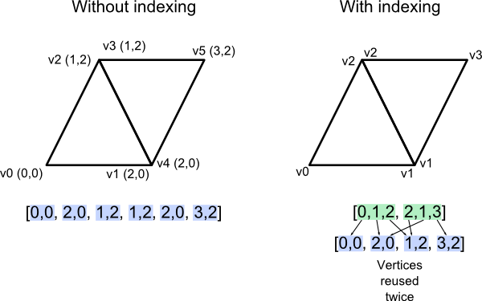
Index Buffer

Slide 4
Index Buffer
var coords = new Float32Array( [-1.0, -1.0, 1.0, //v0
1.0, -1.0, 1.0, //v1
1.0, 1.0, 1.0, //v2
-1.0, 1.0, 1.0 //v3
] );
var colors = new Float32Array( [ 0.0, 1.0, 0.0, //color at v0
0.0, 1.0, 0.0, //color at v1
0.0, 1.0, 0.0, //color at v2
0.0, 1.0, 0.0 //color at v3
] );
var indices = new Uint8Array( [ 0,1, 2, 0, 2, 3 ] );

Slide 5
Index Buffer
bufferInd = gl.createBuffer();
gl.bindBuffer(gl.ELEMENT_ARRAY_BUFFER, bufferInd);
gl.bufferData(gl.ELEMENT_ARRAY_BUFFER, indices, gl.STATIC_DRAW);
// gl.drawArrays(.....);
gl.drawElements( gl.TRIANGLES, 3*2, gl.UNSIGNED_BYTE, 0 );

Slide 6
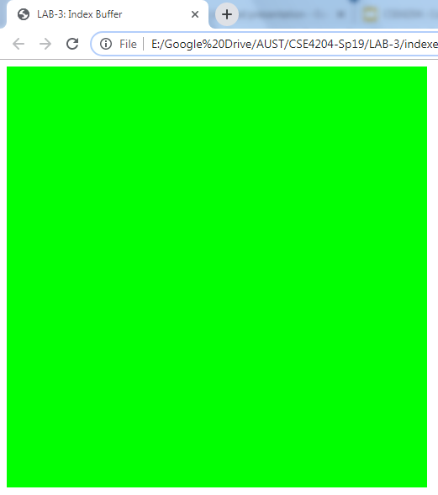
Index Buffer
bufferInd = gl.createBuffer();
gl.bindBuffer(gl.ELEMENT_ARRAY_BUFFER, bufferInd);
gl.bufferData(gl.ELEMENT_ARRAY_BUFFER, indices, gl.STATIC_DRAW);
// gl.drawArrays(.....);
gl.drawElements( gl.TRIANGLES, 3*2, gl.UNSIGNED_BYTE, 0 );

Slide 7
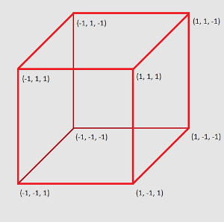
Index Buffer
gl.drawElements( gl.TRIANGLES,
_________,
gl.UNSIGNED_BYT,
0 );

Slide 8
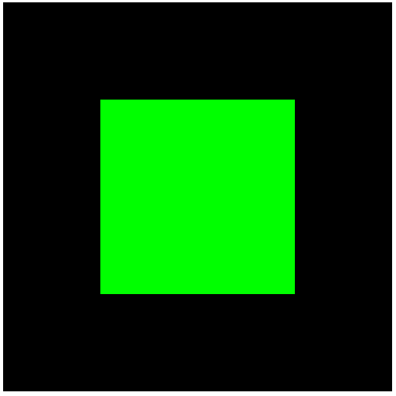
Index Buffer

Slide 9
Transformation
Translation
Scaling
Rotation

Slide 10
Scaling
var vertexShaderSource =
`attribute vec3 a_coords;
attribute vec3 a_colors;
varying vec3 v_color;
void main() {
gl_Position = vec4( a_coords * 0.5, 1.0 ); // V = U * s
v_color = a_colors;
}`;

Slide 11
Scaling
var vertexShaderSource =
`attribute vec3 a_coords;
attribute vec3 a_colors;
varying vec3 v_color;
void main() {
gl_Position = vec4( a_coords * ________, 1.0 );
v_color = a_colors;
}`;

Slide 12
Scaling
var vertexShaderSource =
`attribute vec3 a_coords;
attribute vec3 a_colors;
uniform float u_scale;
varying vec3 v_color;
void main() {
gl_Position = vec4( a_coords * u_scale, 1.0 );
v_color = a_colors;
}`;

Slide 13
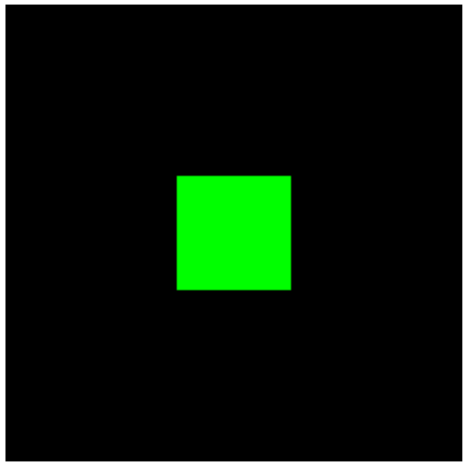
Scaling
u_scale_location = gl.getUniformLocation(prog, "u_scale");
var scale = 0.5;
gl.uniform1f (u_scale_location, scale);

Slide 14
DEPTH_TEST
gl.clearColor (0.0,0.0,0.0,1);
gl.enable (gl.DEPTH_TEST);
gl.enable(gl.CULL_FACE);
gl.clear (gl.COLOR_BUFFER_BIT | gl.DEPTH_BUFFER_BIT);
gl.drawElements(gl.TRIANGLES, 3*12, gl.UNSIGNED_BYTE, 0);

Slide 15
Functions in GLSL
var vertexShaderSource =
`.....................
…………….
void main() {
……………………………….
float rad = radians ( angle_in_degree );
float rx = a_coords.x * cos ( rad ) + ………..;
gl_Position = vec4 ( rx, …………….);
}`;

Slide 16
Rotation
Vx = Ux * cos(theta) + Uz * sin(theta)
Vy = Uy
Vz = - Ux * sin(theta) + Uz * cos(theta);

Slide 17
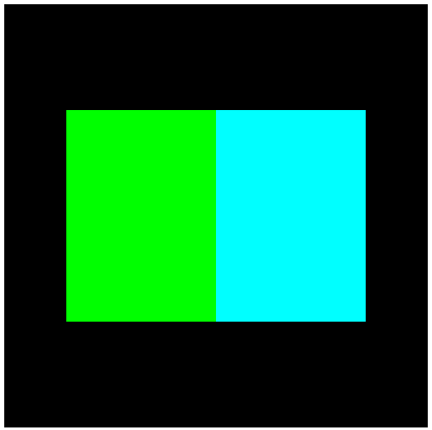

Rotation
var vertexShaderSource =
`attribute vec3 a_coords;
attribute vec3 a_colors;
uniform float u_rotate;
varying vec3 v_color;
void main() {
float rad = radians(u_rotate);
float rx = a_coords.x*cos(rad) + a_coords.z*sin(rad);
float ry = a_coords.y;
float rz = -a_coords.x*sin(rad) + a_coords.z*cos(rad);
gl_Position = vec4(rx, ry, rz, 1.0);
v_color = a_colors; }`;

